Slide 1
CS 345 Visualization and Plotting
Marco Canini

Slide 2
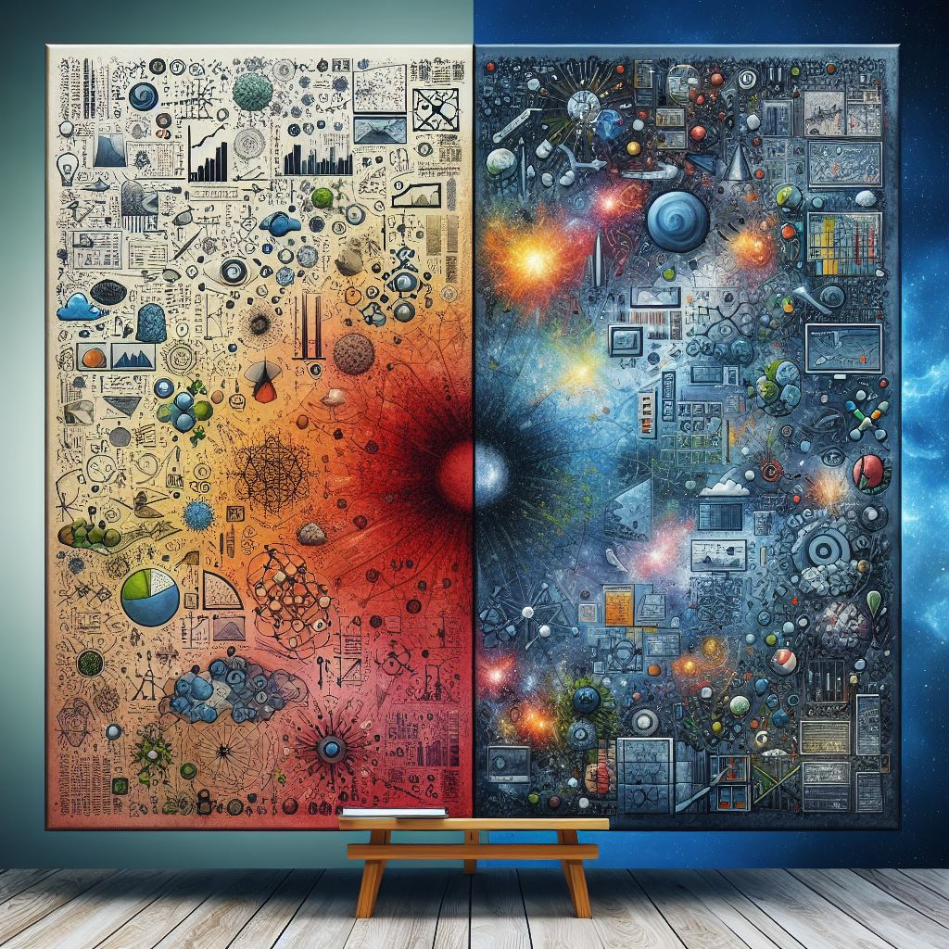
Few basics
Papers aren’t just text
Humans tend to parse well with visuals
Effective figures suggest an understanding and interpretation of data

Slide 3
Scientific data visualization
“Process of graphically displaying scientific data”
Process is far from direct or automatic
Many different ways to represent the same data
E.g., bar plots, linear plots, scatter plots, violin plots, etc.
Also, same data and same plot may be perceived differently depending on who is looking at the figure

Slide 4
Plot quality rule
Quality of a plot ~= 1 / (Time reader takes to understand it)
It pays off to produce clear plots
But it takes effort
Takeaway: don’t be sloppy

Slide 5
Plan for today
Offer some guidance on
Principles
Tools
Hints
To effective scientific data visualization
Lecture inspired from:
“Principles of Effective Data Visualization,” S. R. Midway, https://doi.org/10.1016/j.patter.2020.100141
“Ten Simple Rules for Better Figures,” N. P. Rougier, M. Droettboom, P. E. Bourne, https://doi.org/10.1371/journal.pcbi.1003833

Slide 6
Focus on the message first
A figure serves to convey a concept or a result that would be impractical to describe solely through text
Identify the role of the figure: what is the underlying message and how can a figure best express this message?
Focus on the information you want to share: envision & design it
Hint: use inspiration from figures you come across

Slide 7
Use the right geometry
Geometries are representations of the data in different forms
Often there may be more than one geometry to consider
Rule of thumb: use high data-ink ratio
The ratio of ink used on data compared with overall ink used in a figure
Hints: use figures you encountered in the literature as evidence, consult toolkit galleries
https://matplotlib.org/stable/gallery/index.html
https://r-graph-gallery.com/
https://plotly.com/python/plotly-fundamentals/

Slide 8
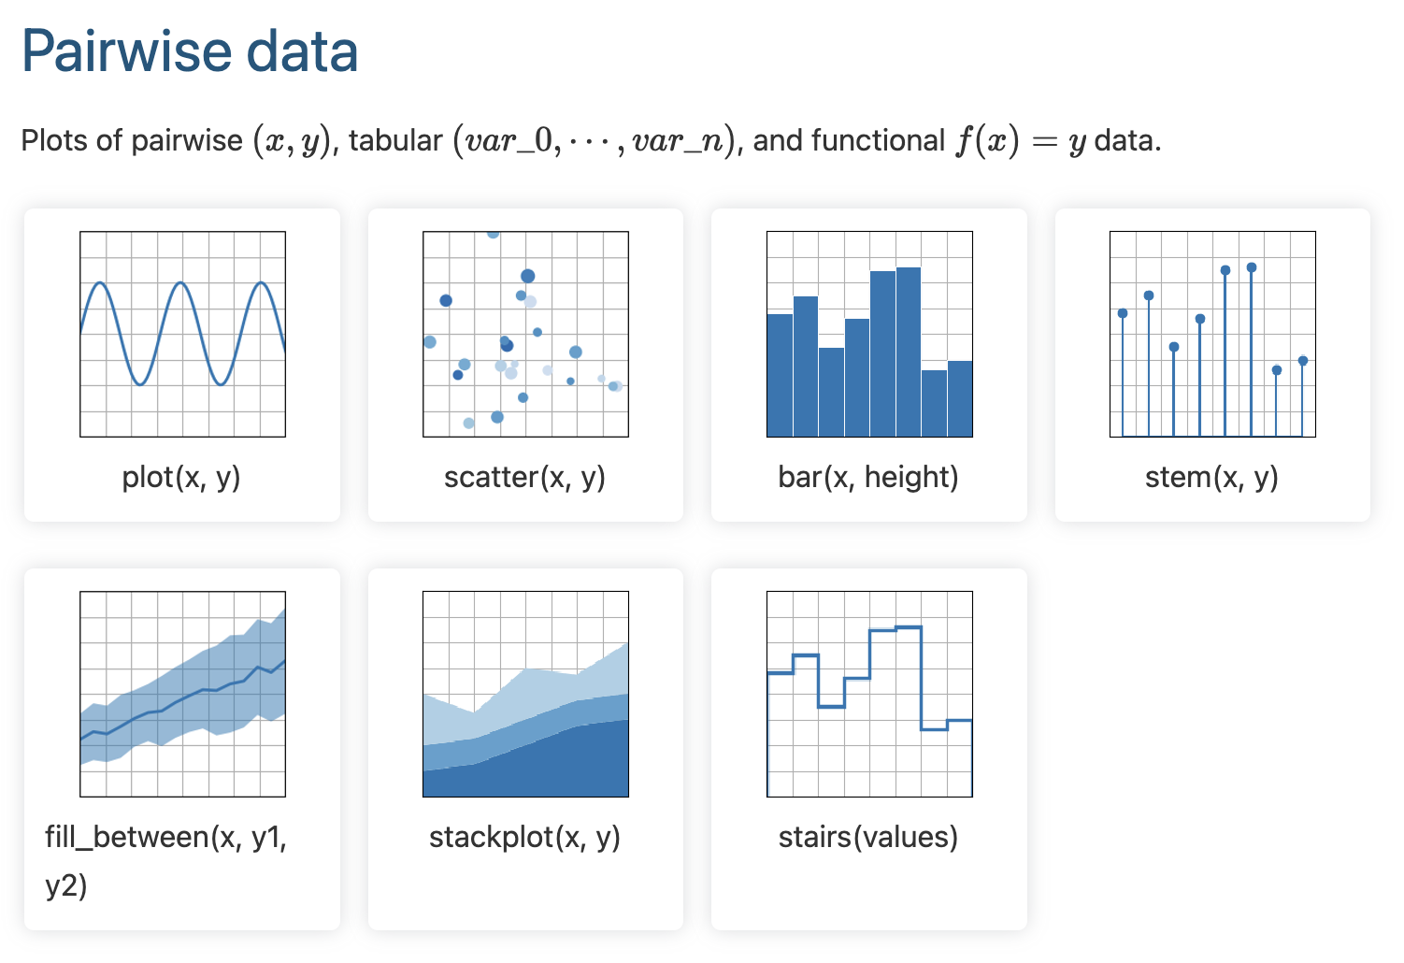

Slide 9
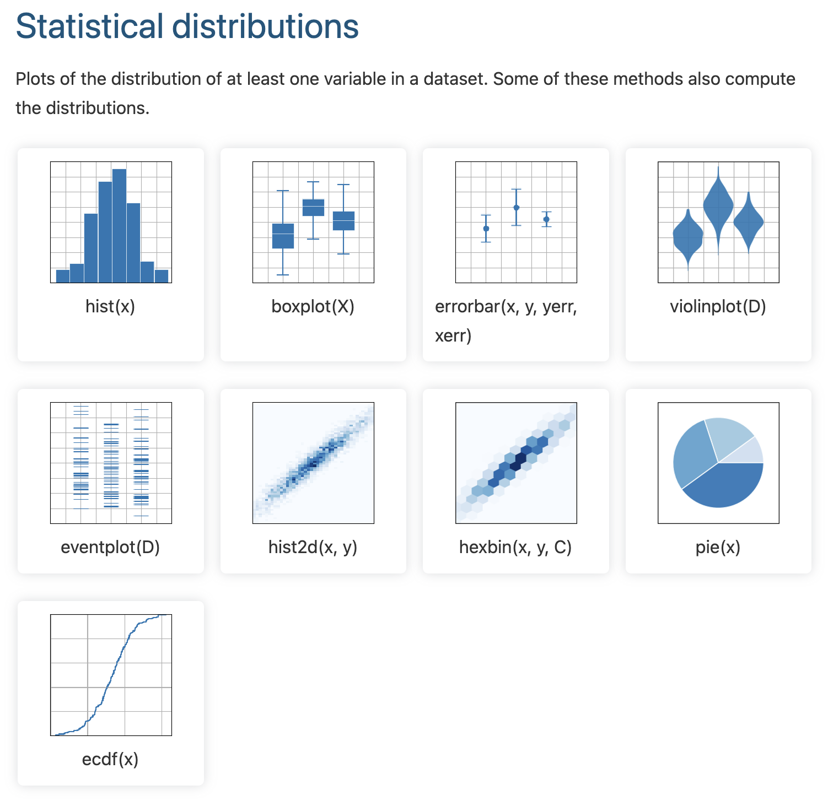

Slide 10
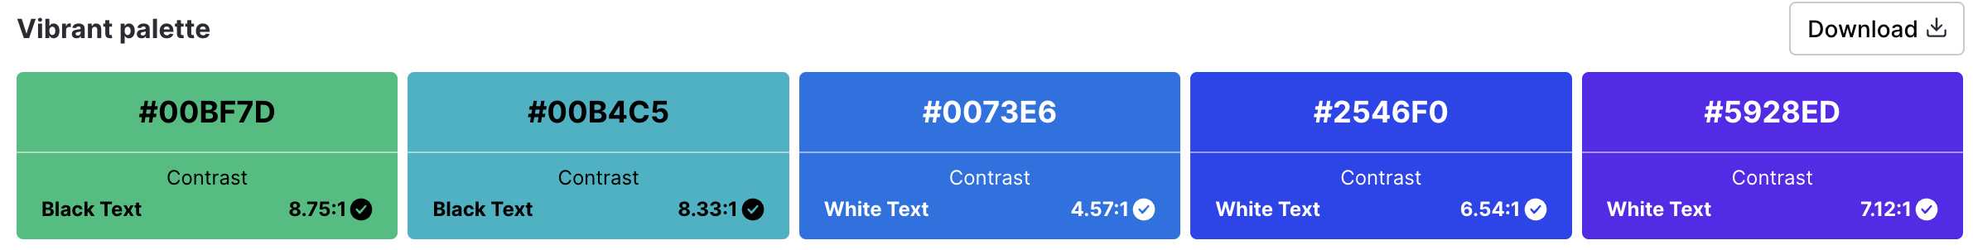
Colors always mean something
Whether obvious or subtle, color represents information: Use it!
Hints: not all colors are created equal
Figures should work effectively in both color and black-and-white formats
Use color schemes that are effective for colorblind readers
https://colorbrewer2.org/
https://venngage.com/tools/accessible-color-palette-generator
https://davidmathlogic.com/colorblind/

Slide 11
Adapt figures to the support medium
Paper, projection screen, poster: each has different size and ways to view and interact with the figure
During presentation, figure will be displayed for limited time
Viewer must quickly understand it while listing to presentation
Figure must be kept simple and message must be visually salient
Use thicker lines or bigger points/text, colors with high contrast
For a paper, a viewer can view figure as long as necessary
Can use a lot of details, along with complementary explanations in the caption
However, the figure should be readable in print!

Slide 12
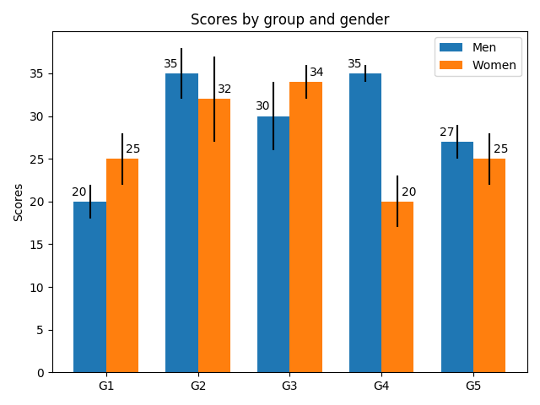
Include uncertainty
Failure to include uncertainty in a visual can be misleading
Typically easy to include via error bars or shaded intervals
However, be cautious about the measures of representing uncertainty
Standard deviation, standard error, confidence intervals
Ensure that the message conveys the correct interpretation

Slide 13
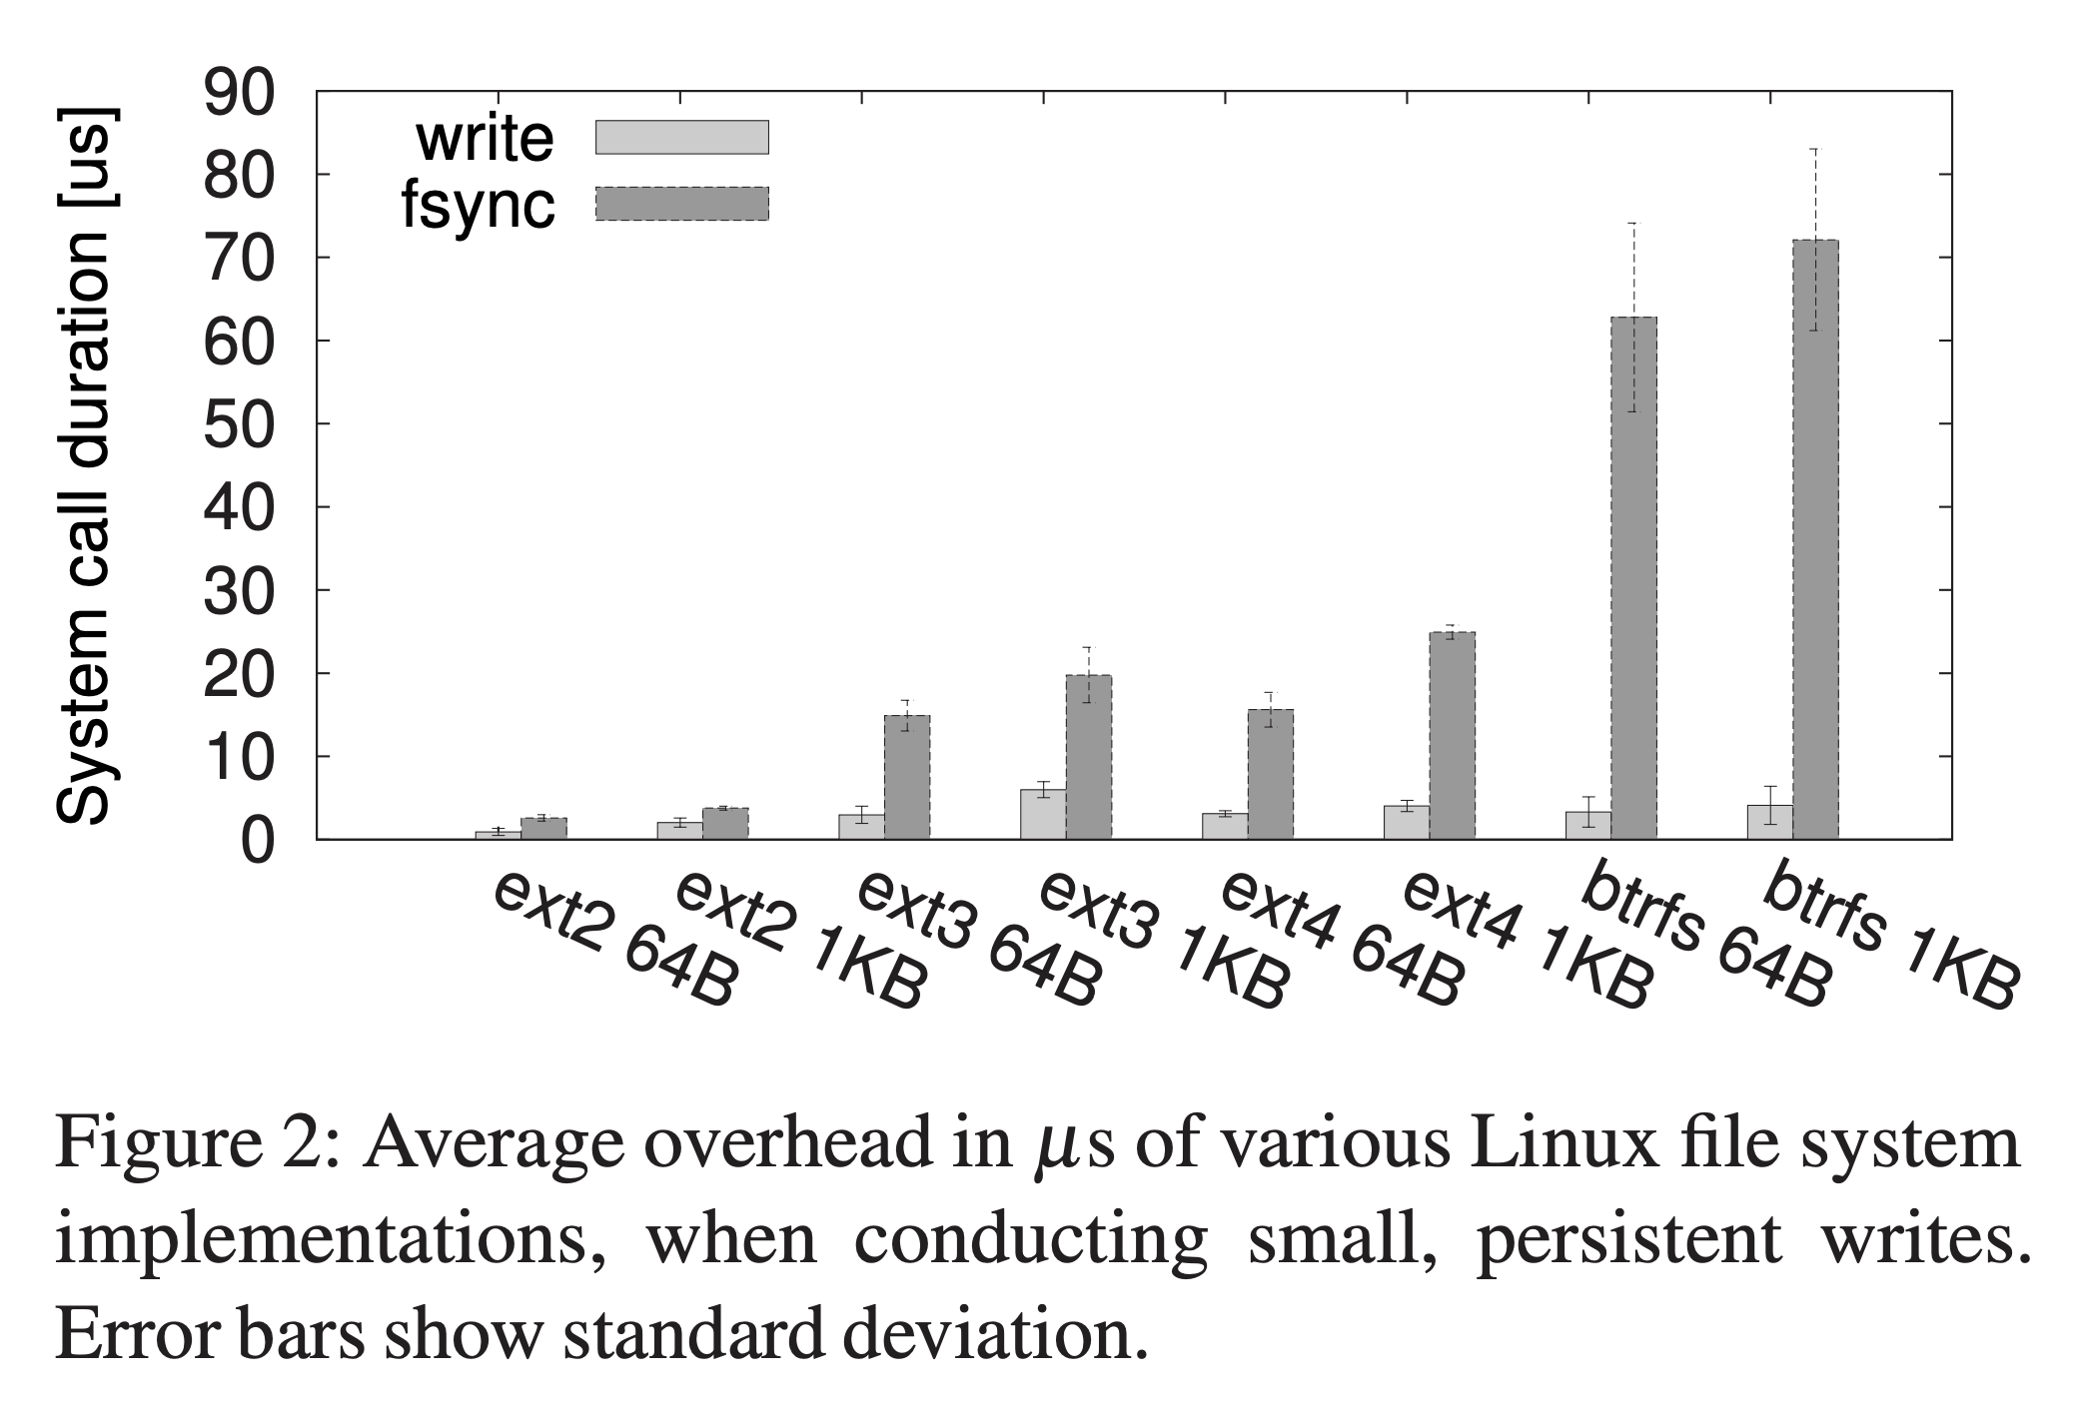
Detailed captions
Important to have detailed captions that gully explain everything in the figure
The caption explains how to read the figure and provides additional precision for what cannot be graphically represented
Bad example: Figure 2: System overheads.

Slide 14
Detailed captions
Important to have detailed captions that gully explain everything in the figure
The caption explains how to read the figure and provides additional precision for what cannot be graphically represented

Slide 15
Use the right software
Effective visuals typically require good command of one or more software (most comes for free!)
Matplolib, plotly, ggplot2, may other viable options
Presentation software like PowerPoint has native plotting support
Interactive data visualization toolkits e.g. D3.js
Hints: Know your tools well!
Don’t trust the default
Keep improving until the figure is clear enough

Slide 16
-55%
The above plot is made within PowerPoint (with data that live in a spreadsheet)
It looks slick and can be customized and animated for a more effective presentation

Slide 17
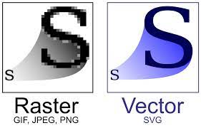
Avoid raster graphics if possible
When including graphics in papers or presentations, avoid raster graphics
In vector graphics, visual elements are created directly from geometric shapes
The viewer can zoom in without experiencing loss of details
Matplotlib and drawing tools like draw.io export visuals as PDFs, and these can be included in LaTex or PowerPoint directly

Slide 18
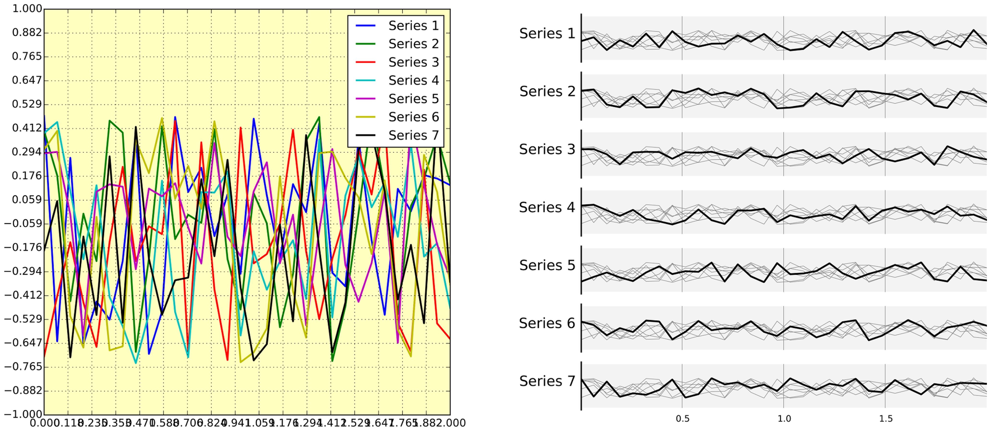
Avoid “Chartjunk”
Chartjunk: all the unnecessary visual elements that do not improve the message or add confusion
E.g., use of too many colors, too many labels, gratuitously colored backgrounds, useless grid lines, etc.
Source: Ten Simple Rules for Better Figures
N. P. Rougier, M. Droettboom, P. E. Bourne

Slide 19
Don’t kill your time
Making the first draft of a figure is 10% of the effort; the other 90% is successive refinement and it takes time
Develop good infrastructure for plotting
Know your tools
Script things like a maniac
Hint: Decouple raw data processing from plotting
Refine
Raw Data
(Many MBs / GBs)
Figure
~Minutes
Long pre-processing times are a huge pain

Slide 20
Don’t kill your time
Making the first draft of a figure is 10% of the effort; the other 90% is successive refinement and it takes time
Develop good infrastructure for plotting
Know your tools
Script things like a maniac
Hint: Decouple raw data processing from plotting
Refine
Raw Data
(Many MBs / GBs)
Plot Data (A few KBs)
Figure
~Minutes
~Seconds

Slide 21
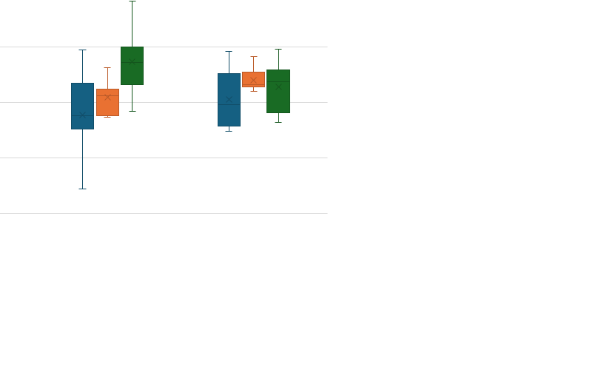
Don’t kill other people’s time
Is the figure ready for sharing?

Slide 22
Don’t kill other people’s time
Is the figure ready for sharing?
Hint: if the figure generates basic questions like what is the x/y-axis, what are the units, what are the error bars, what is “Line 1”, etc. probably the figure is not ready for sharing
It will take more time for people to understand it than if you had spent a bit more effort to polish the figure

Slide 23
What about tables?
Tables are often summarized values or information
Tables are effective if the goal is to reference exact numbers
Graphs are better for perceiving trends and making comparisons and predictions

Slide 24

The empirical CDF plot (ECDF)
https://colab.research.google.com/drive/1OEG16-J2snSk5RQFe07HJ4nE4kKhaZM3?usp=sharing

Slide 25
Additional resources
Wilke, Claus O. 2019. Fundamentals of Data Visualization: A Primer on Making Informative and Compelling Figures ISBN 978-1-492-03108-6
Consult: https://matplotlib.org/stable/users/resources/index.html

